Slide 1
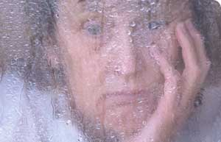
The clinical picture of depression
Prof dr Bert van Hemert
Psychiater

Slide 2

Sadness
Grief
Clinical Depression

Slide 3
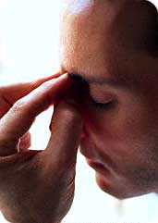
Symptoms of depression
Depressed mood
Anhedonia
Tearfulness
Irritability
Low energy level
Guilt
Suicide thoughts and acts

Slide 4
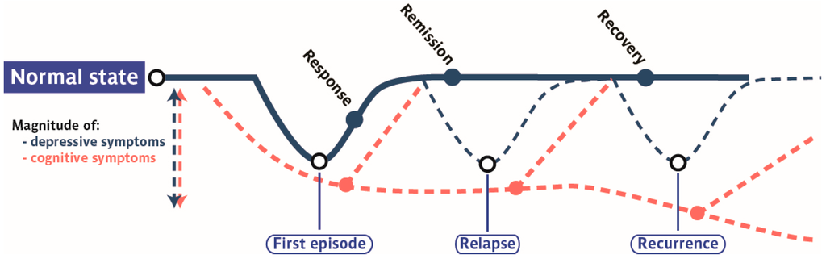
Prolonged episodes
Combinations of symptoms
Severity of symptoms
Discontinuity with ordinary functioning
Interference with daily funtioning

Slide 5
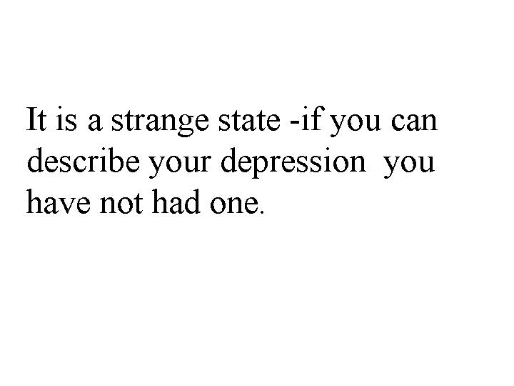
Prof. Lewis Wolpert, Ph.D.,
Professor of Biology as Applied to Medicine at University College London

Slide 6
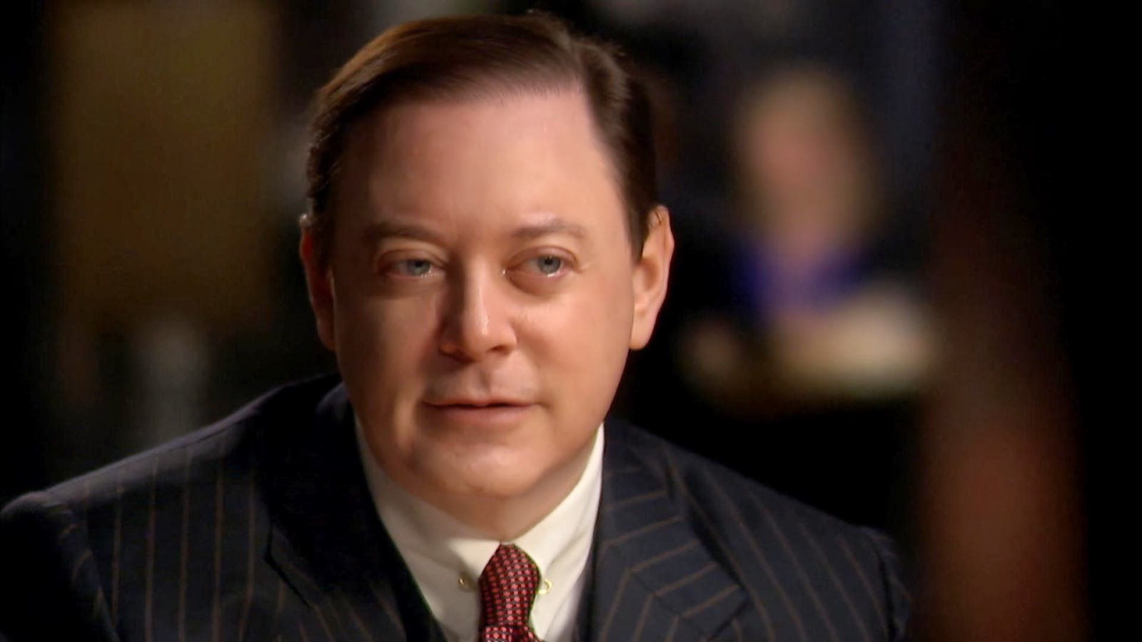
Andrew Solomon
Depression – The secret we share
https://www.youtube.com/watch?v=-eBUcBfkVCo#t=1285.243202

Slide 7
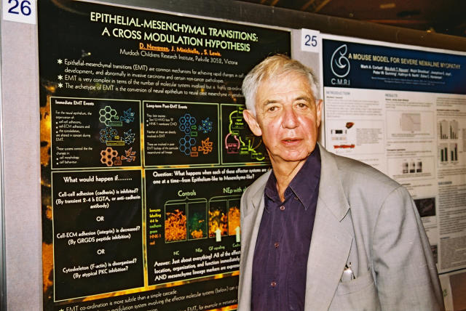
Prof. Lewis Wolpert, Ph.D.,
Professor of Biology as Applied to Medicine at University College London

Slide 8


Slide 9


Slide 10
“Until one has experienced a debilitating depression it is hard to understand the feelings of those who have. Severe depression confounds any attempt at description: it is not just feeling much lower than usual. It is quite a different state, one that bears only a tangential resemblance to normal emotion. It deserves some new and special word of its own that can encapsulate both the pain and the conviction that no remedy will ever be available.”
    “Malignant Sadness:
    The Anatomy of Depression”
    Lewis Wolpert (1999)

Slide 11
“It was the worst experience of my life. More terrible even than watching my wife die of cancer. I am ashamed to admit that my depression felt worse than her death, but it is true. I was in a state that bears no resemblance to anything I had experienced. It was not just feeling very low, depressed in the commonly used sense of the word. I was seriously ill.”
    “Malignant Sadness:
    The Anatomy of Depression”
    Lewis Wolpert (1999)

Slide 12

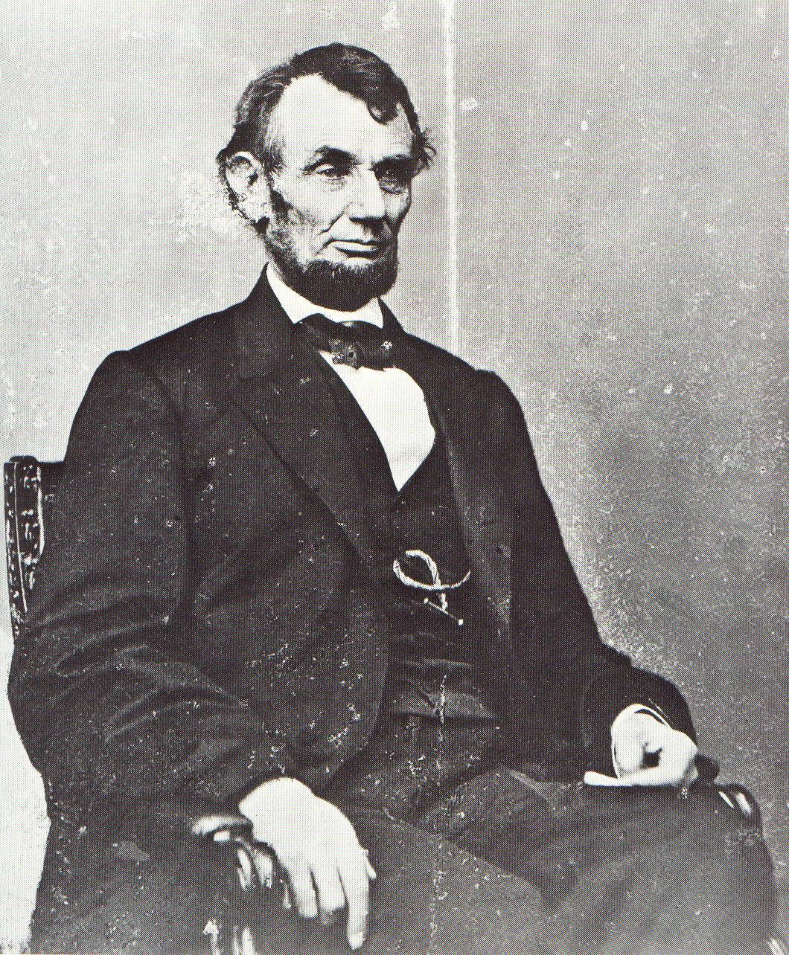
Abraham Lincoln
I am now the most miserable man living. If what I feel were equally distributed to the whole human family, there would not be one cheerful face on the earth. Whether I shall ever be better I can not tell; I awfully forebode I shall not. To remain as I am is impossible; I must die or be better, it appears to me.

Slide 13

Approximately 6% of the population suffer from a depressive illness in any given year
Depression affects nearly twice as many women as men

Slide 14

The Global Burden of Disease
Depression was leading global cause of disability among all medical and surgical illnesses (1990 figures)
Depression was fourth leading cause of disease burden (1990 figures)
Depression will be second leading cause of disease burden by 2020

Slide 15
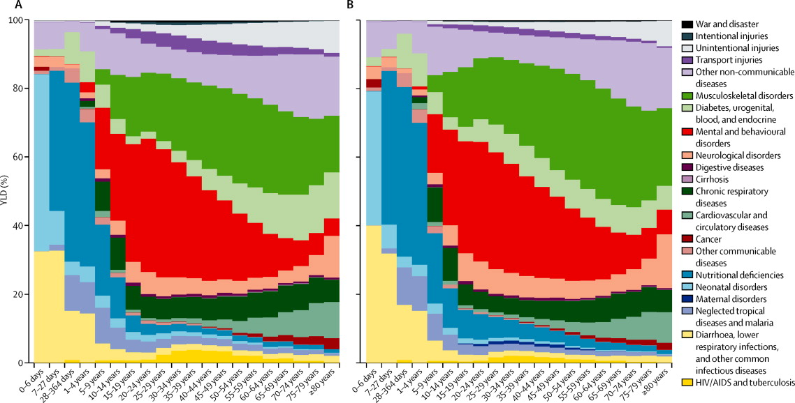
Percentage of years lived with disability (YLDs) in 2010,
by cause and age(A) In male individuals. (B) In female individuals
Global Burden of Disease Study 2010 Lancet 2013; 380, 2163–2196

Slide 16
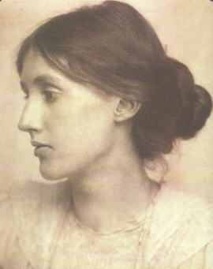
Virginia Woolf

Slide 17

Reaching the river,
she filled her pockets
with stones,
left her walking stick
on the ground,
and walked
into the icy waters.

Slide 18
I want to tell you that you have given me
complete happiness....Please believe that.
But I know I shall never get over this; and
I am wasting your life. Nothing anyone says
can persuade me...... All I wish to say is
that until this disease came on me we were
perfectly happy....

Slide 19

Depression and suicide
Incidence risk ratio: 12-20
Harris, E.C., & Barraclough, B. (1997). Suicide as an outcome for mental disorders: A meta-analysis. The British Journal of Psychiatry, 170, 205-228.
Population attributive risk: 30-60%
Cavanagh, J.T.O., Carson, A.J., Sharpe, M., & Lawrie, S.M. (2003). Psychological autopsy studies of suicide: A systematic review. Psychological Medicine, 33, 395-405.

Slide 20

Treatment of depression
Biological
Psychotherapy
Daily activities
Medication
Electroconvulsive therapy
Cognitive behavioral therapy (CBT)
Mindfulness

Slide 21
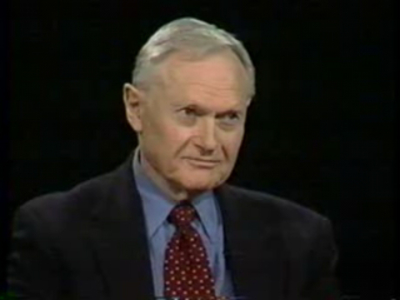
Sherwin Nuland about ECT
https://www.youtube.com/watch?v=oEZrAGdZ1i8

Slide 22
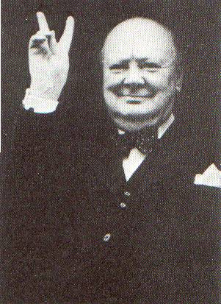
“I don't like to stand by the side of a ship and look down into the water. A second's action would end everything.”
Winston Churchill

Slide 23

“I don't like to stand by the side of a ship and look down into the water. A second's action would end everything.”
Winston Churchill

Slide 24

http://www.blackdoginstitute.org.au/aboutus/overview.cfm

Slide 25
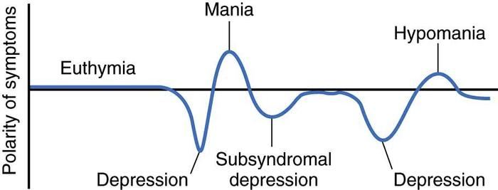
Bipolar disorder

Slide 26

Symptoms of manic episode
Elated mood, euphoria
Irritability
High energy level
Irresponsible behaviour
Life threatening behaviour

Slide 27
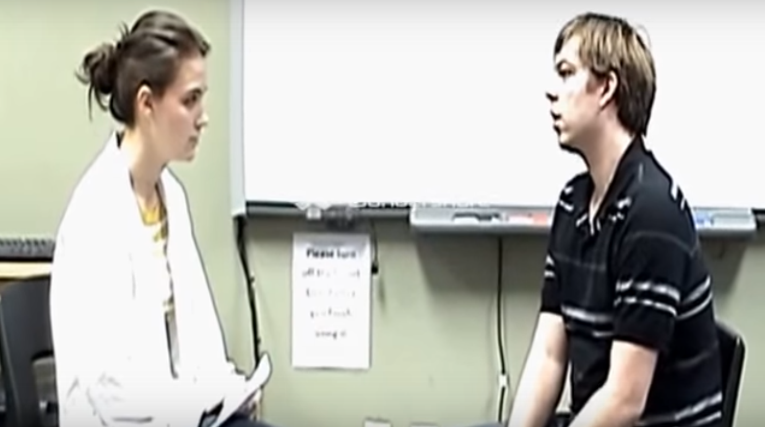
Manic-depressive illness
https://www.youtube.com/watch?v=AxE6XMjuh_w

Slide 28
The clinical picture of depression
Prof dr Bert van Hemert
Psychiater
Difference between normal and abnormal sadness
The clinical picture of depression
Depression and suicide
Treatment of depression – ECT
Bipolar disorders and manic episodes

